Slide 1
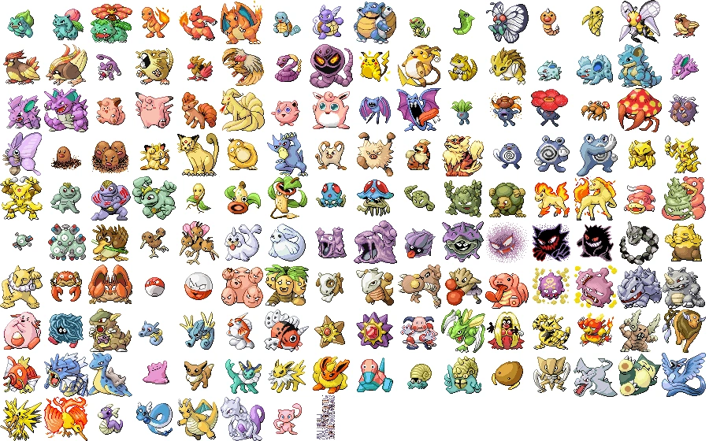
Pokémon
Six vs Elite Four
Corinne Desroches
Hayden Burger
David Lee
Notes:
When we last saw our heroes: Data and code from previous Monte Carlo
Problem statement: How can we shape a team to take on the elite team the fastest?
Slide on flowchart
Slide on event relationship graph
Slide on assumptions: Pokémon have access to all moves, all level 50,etc
Expand to 6 v 5 team battles
Expand to 1 team vs 4 teams
Expand to level 50 – random moves from them
Expand to track time in the battle with 6 seconds per round.
Attempt to input it into Simio – Constant problems multiple servers, multiple customers, each customer has different interactions with each server, multiple distributions
Realize that it’s easier to implement in Python
Team choices – High defense, high attack,
Results
Team Gyarados
Team Gengar
Hayden's main team - All Legendaries + Cool Turtle
Hayden's second team - no legendaries
Hayden's fighting team
Hayden's high hp team
Top Winners
Corinne's vague attempt at type matching
Just Birds
David's nostalgia

Slide 2
Pokémon: game franchise where players battle with teams of fantasy creatures
Complex rock-paper-scissors-etc style elemental types give advantage and disadvantage
Speed, attack, defense, type advantage, hit points, status effects, move sets, etc. for each Pokémon
Teams of up to six
Elements of strategy show up via team order, team type, team stat composition, and multi-team strategies
Elements of luck from the battle equation which involves RNG for damage and critical hit calculations
The Elite Four are one of the final challenges for a player
A sequence of four teams to beat and become the Pokémon Champion
When we last left our heroes…
Previous model only handled 1v1 battles at level 1, and did not track any time component
Results
Mechanics
Background
Experiments
Assumptions
Data
Notes:
Intro the idea of Pokemon (briefly)
Rubric Problem Background
5 points. Introduction to the area of research and any
terminology used. Define study objective(s) and research question(s). What
Measures of Performance are critical.

Slide 3
Problem statement
How can we most efficiently beat the Elite Four’s teams of five Pokémon?
Measures of performance
Time (6 seconds per round of actions)
Player’s team must survive the gauntlet of all four teams sequentially (20 total opposing Pokémon)
Results
Mechanics
Background
Experiments
Assumptions
Data
Notes:
Multiple slides?
"How can we best take on the Elite Four in a Timely manner"
Measures of performance: success, number of turns

Slide 4

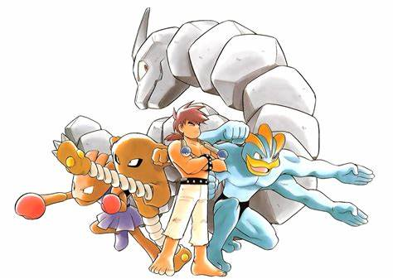
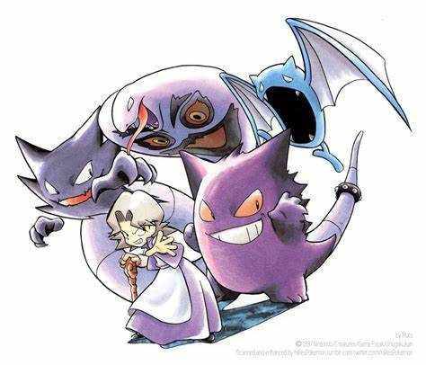
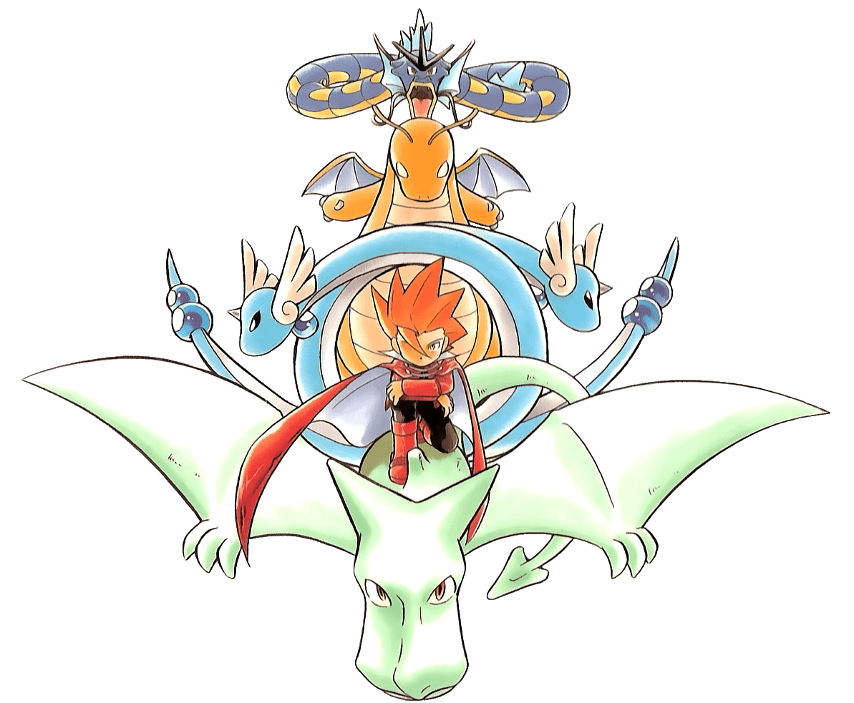
Elite Four Composition
Lorelei (Water/Ice type)
Dewgong, Cloyster, Slowbro, Jynx, Lapras
Bruno (Rock/Fighting type)
Onix, Hitmonlee, Hitmonchan, Onix, Machamp
Agatha (Poison/Ghost type)
Gengar, Golbat, Haunter, Arbok, Gengar
Lance (Dragon type)
Gyarados, Dragonair, Dragonair, Aerodactyl, Dragonite
Results
Mechanics
Background
Experiments
Assumptions
Data
Notes:
Multiple slides?
"How can we best take on the Elite Four in a Timely manner"
Measures of performance: success, number of turns

Slide 5
Constraints, Limitations, Assumptions
Only Pokémon from Generation 1
All Pokémon now at Level 50
Base stats used (ignored IV and EV values)
Moves are randomly picked from all available moves for each Pokémon (to reduce modeler bias)
Full video game battle/damage equation is modeled
PP (move use limits) are ignored, no switching, no items
Testing all 11,853,911,588,401 team combinations repeatedly is computationally expensive
Testing a subset of teams will provide data to make further decisions
Full health reset between the Elite’s teams
Sourced data includes the stats for each Pokémon, equations from the video games, and Generation 1 Elite Four composition
Experiment of 1,000 attempts per player team against the full gauntlet of the Elite Four
Results
Mechanics
Background
Experiments
Data
Assumptions
Notes:
Reorganize
Rubric: Constraints, Limitations, and Assumptions – 5 points.

Slide 6
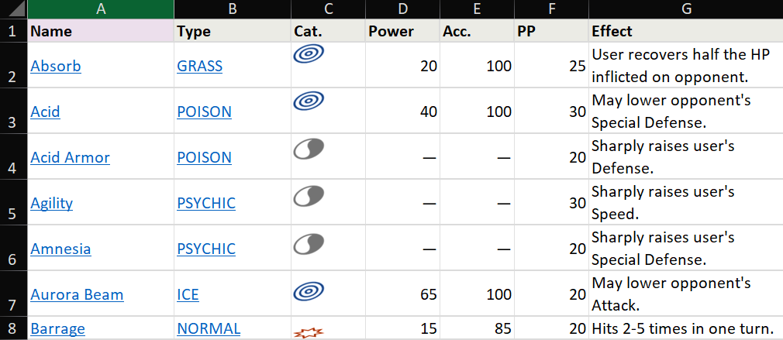
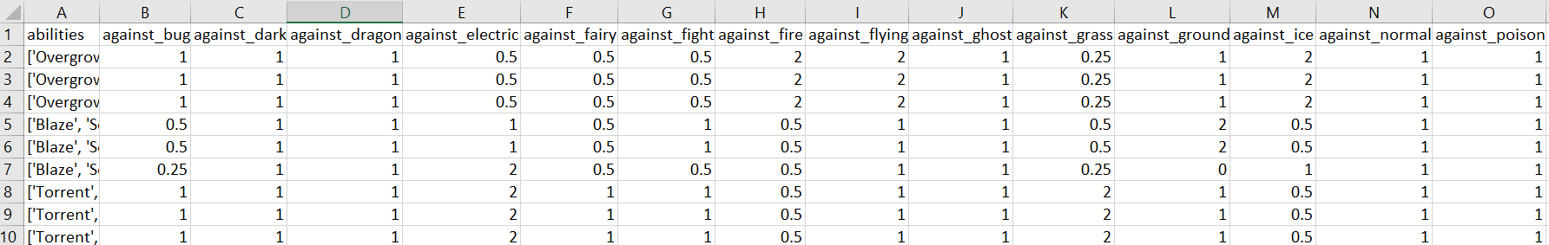
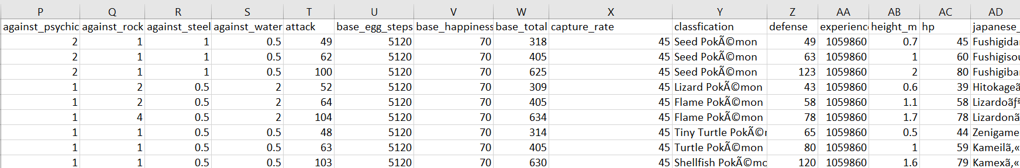
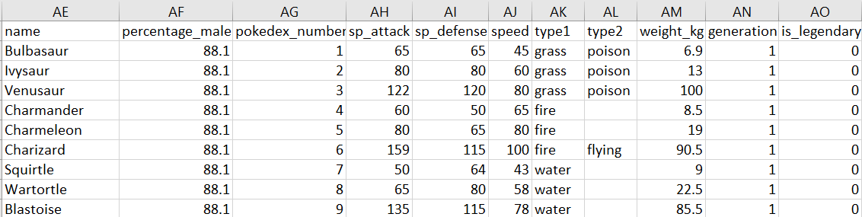
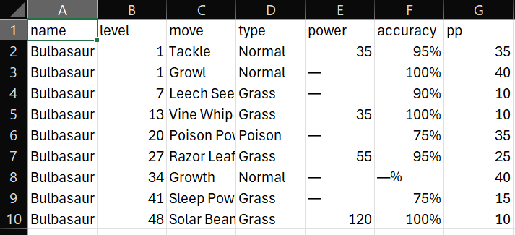
All the data and equations are available readily on sites like Bulbapedia and Serebii, with the collected data files on Kaggle
This data was folded into our model to govern the behavior of every entity and their attacks and interactions
This original, bespoke, high-fidelity model provided us the inputs for the new model
Results
Mechanics
Background
Experiments
Assumptions
Data
Notes:
Rubric: Data – 5 points. Describe data available or not available. If no data was available discuss the reasoning values used were chosen.

Slide 7
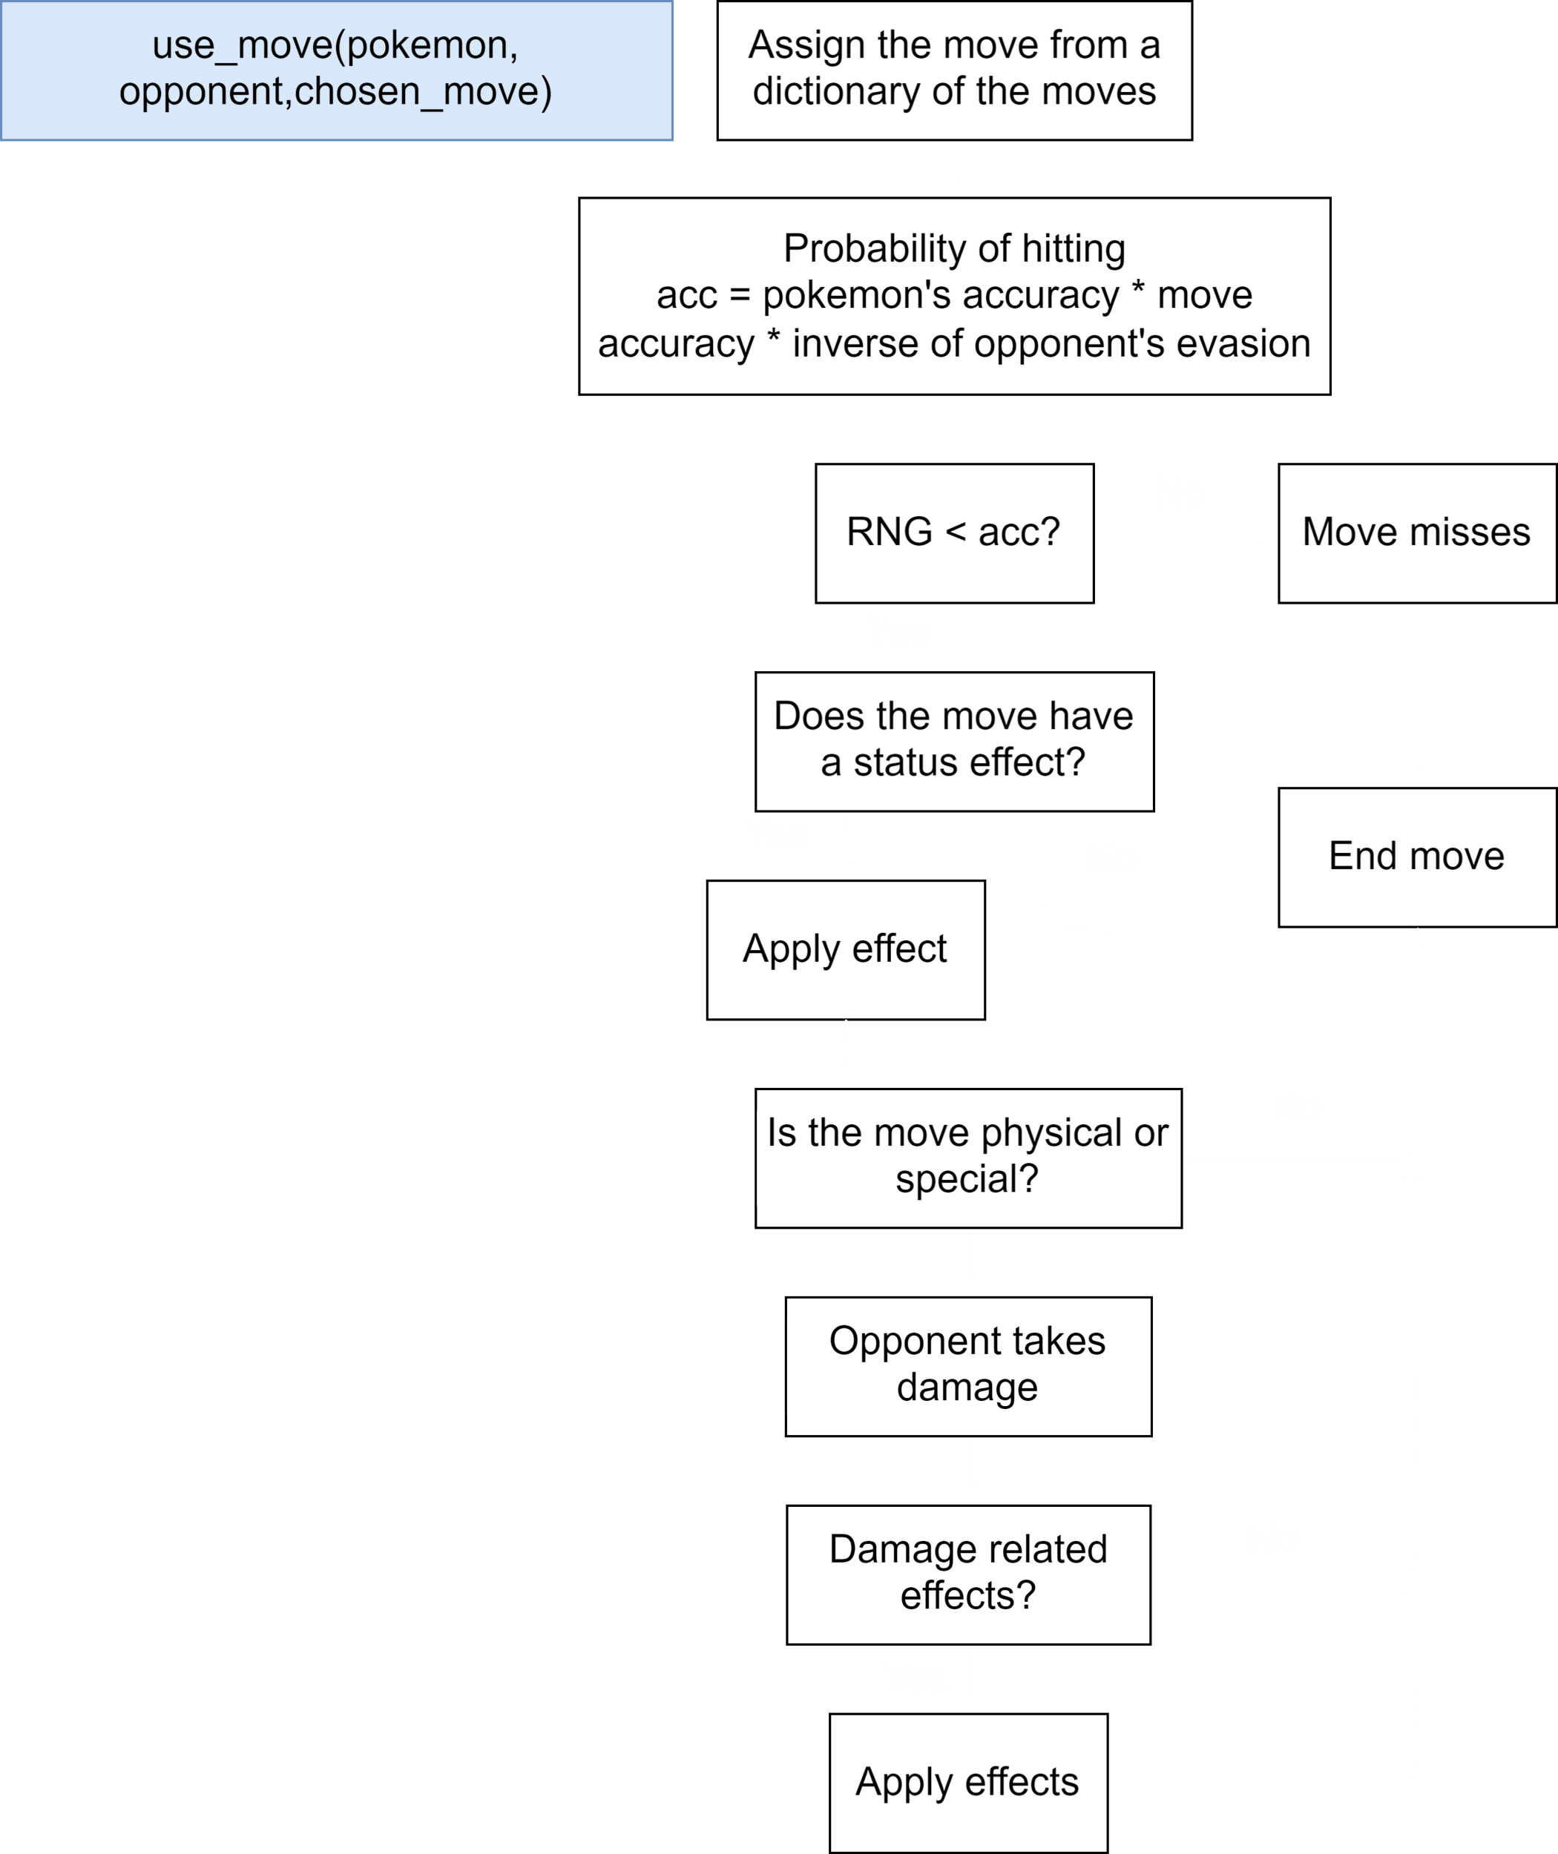
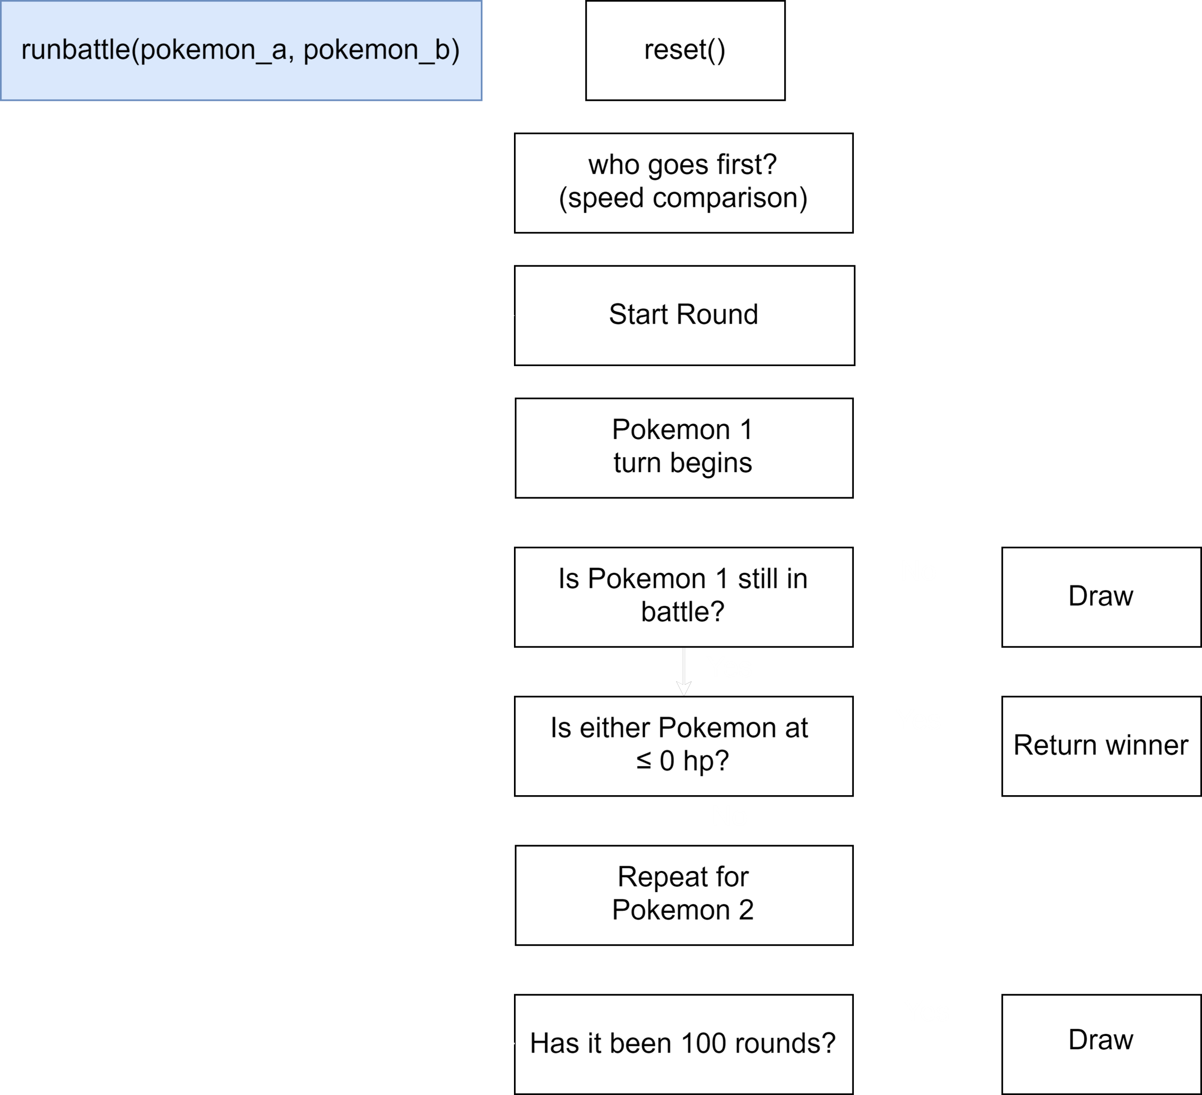
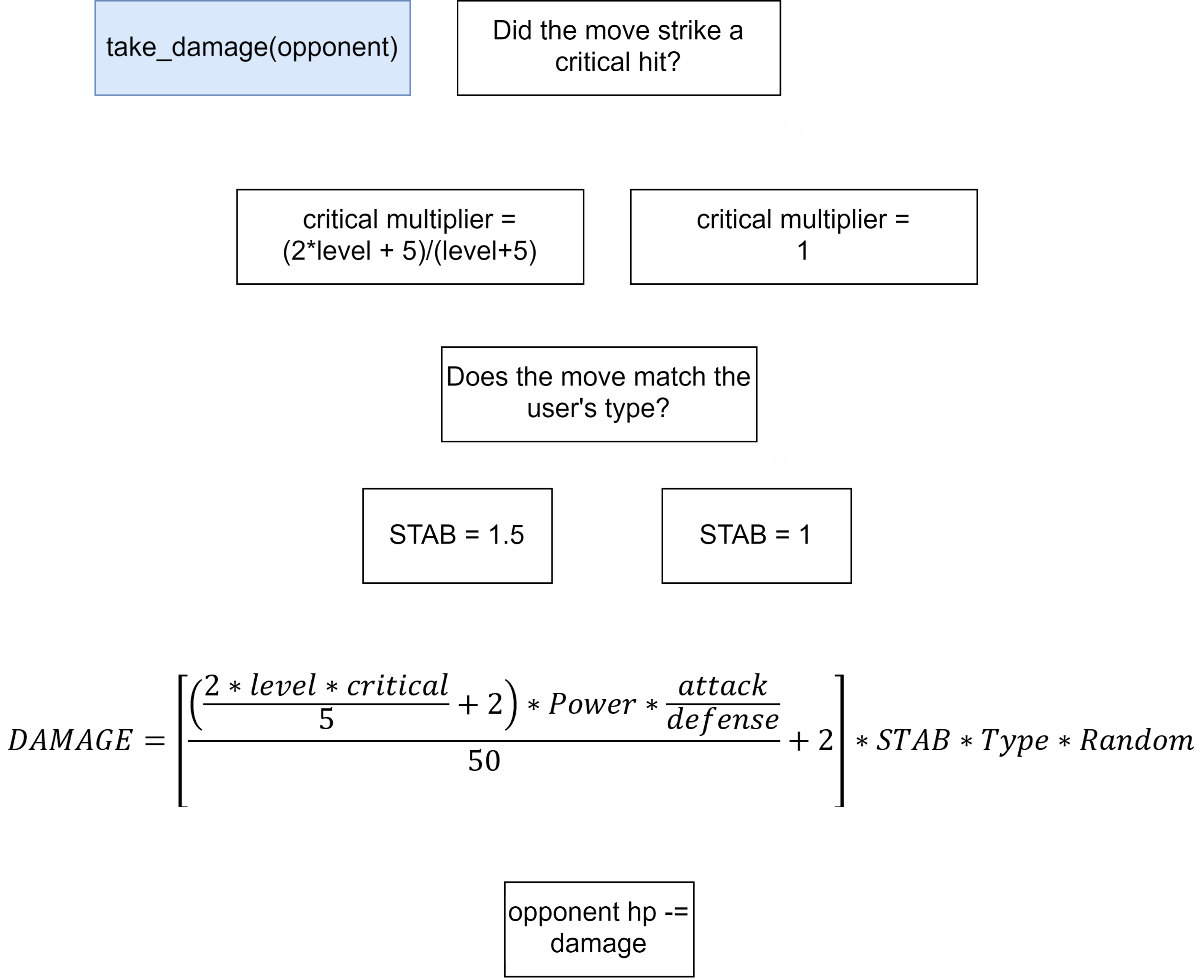
The original model
Results
Mechanics
Background
Experiments
Assumptions
Data
Notes:
Rubric: Model Mechanics – 5 points. Description of the model’s mechanics, flows, interdependencies, etc.

Slide 8
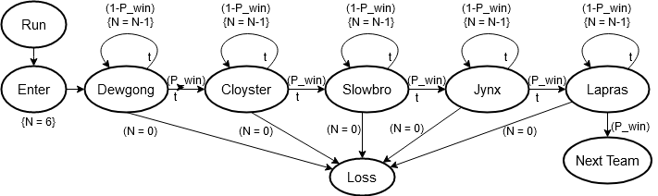
The new model pits pairs of Pokémon against each otherin turn-based combat until a winner is determined (batch arrivals, turn based serving)
When a Pokémon is knocked out, the next member of the respective team is entered into combat (FIFO server and customer)
Whichever team has surviving Pokémon at the end of the battle is declared the winner
If the player’s team is victorious, they are returned to full health and pitted against the team of the next member of the Elite Four (sequential queues)
All the while, the timer is running
Results
Mechanics
Background
Experiments
Assumptions
Data
Notes:
Rubric: Model Mechanics – 5 points. Description of the model’s mechanics, flows, interdependencies, etc.

Slide 9
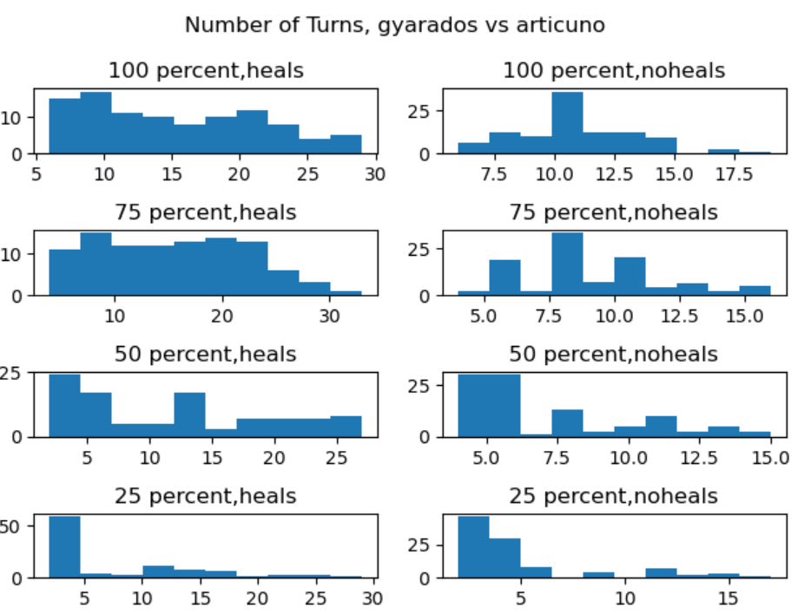
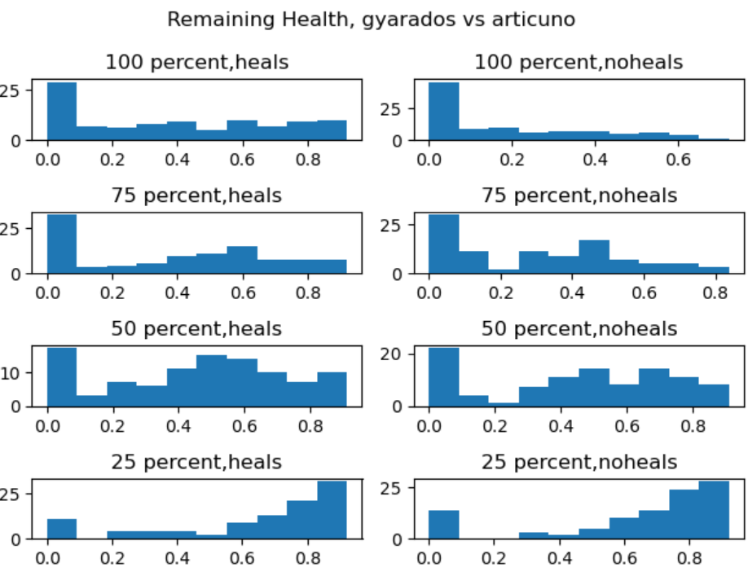
Initial tests were conducted to seek distributions for the Simio model
Every pairing of Pokémon returned different data sets with numerous distributions depending on initial conditions and availability of health resets
Every fitted distribution was fidelity lost, and complexity added to the Simio model
Python was chosen to ultimately run our simulation
Results
Mechanics
Background
Experiments
Assumptions
Data
Notes:
Rubric: Experimental Framework – 5 points. Define how different scenarios performed and compare those results.

Slide 10
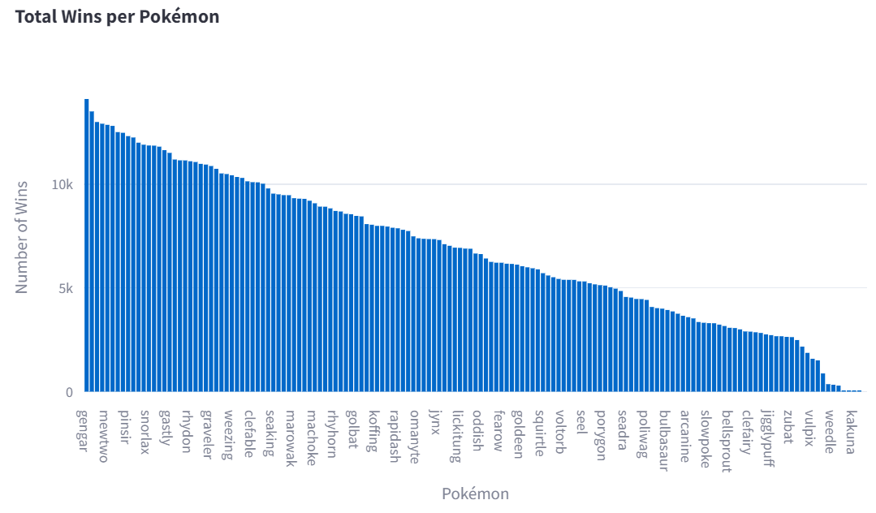
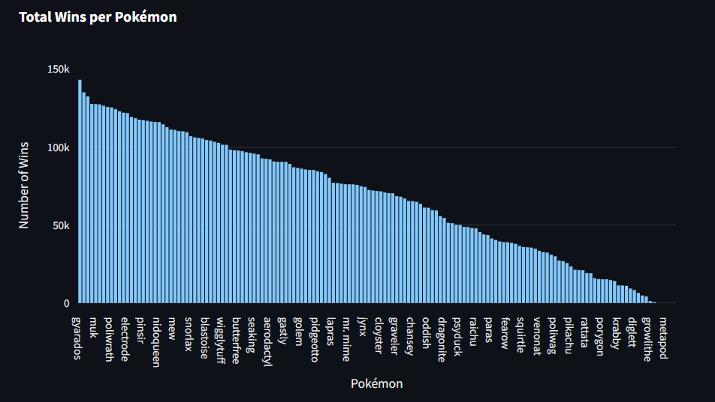
The initial testing showed different winners at level 50 than we had at level 1, with the advent of new and more powerful attacks being available to our competitors
Level 50 Winners
Level 1 Winners
Results
Mechanics
Background
Experiments
Assumptions
Data
Notes:
Rubric: Experimental Framework – 5 points. Define how different scenarios performed and compare those results.

Slide 11
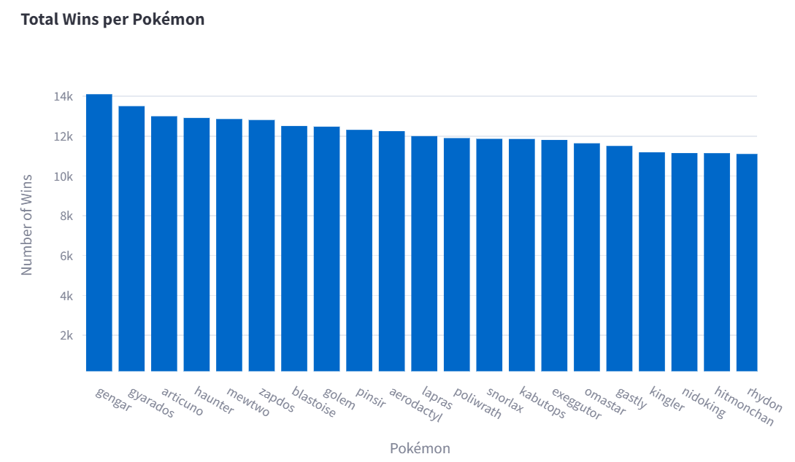
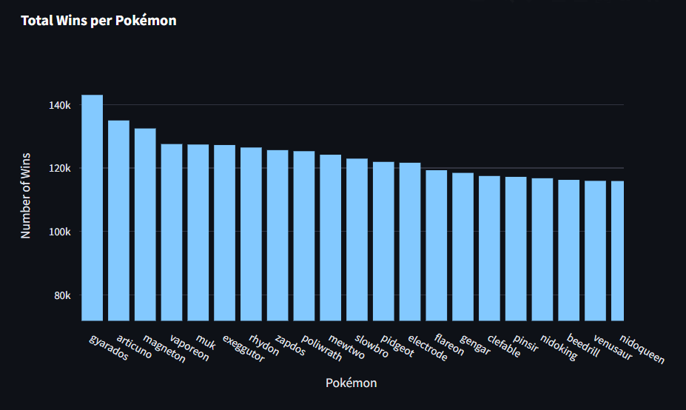
Level 50 Winners
Level 1 Winners
Top winners
The top six here became Team 7
Gengar moves from rank 15 to rank 1
Results
Mechanics
Background
Experiments
Assumptions
Data
Notes:
Rubric: Experimental Framework – 5 points. Define how different scenarios performed and compare those results.

Slide 12
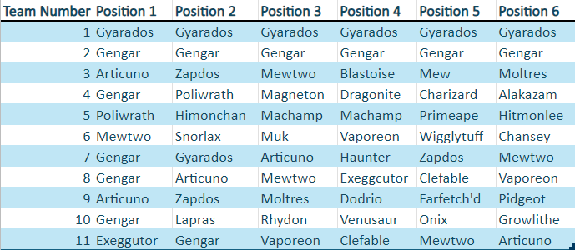
11 teams were chosen for various reasons: previous winners, high hp, high win rate, type advantage, nostalgia, etc.
Every team was run in forward and reverse against the full gauntlet of the Elite Four
These attempts were repeated 1,000 times to find the long-term average speed of the successes
Results
Mechanics
Background
Experiments
Assumptions
Data
Notes:
Rubric: Experimental Framework – 5 points. Define how different scenarios performed and compare those results.

Slide 13
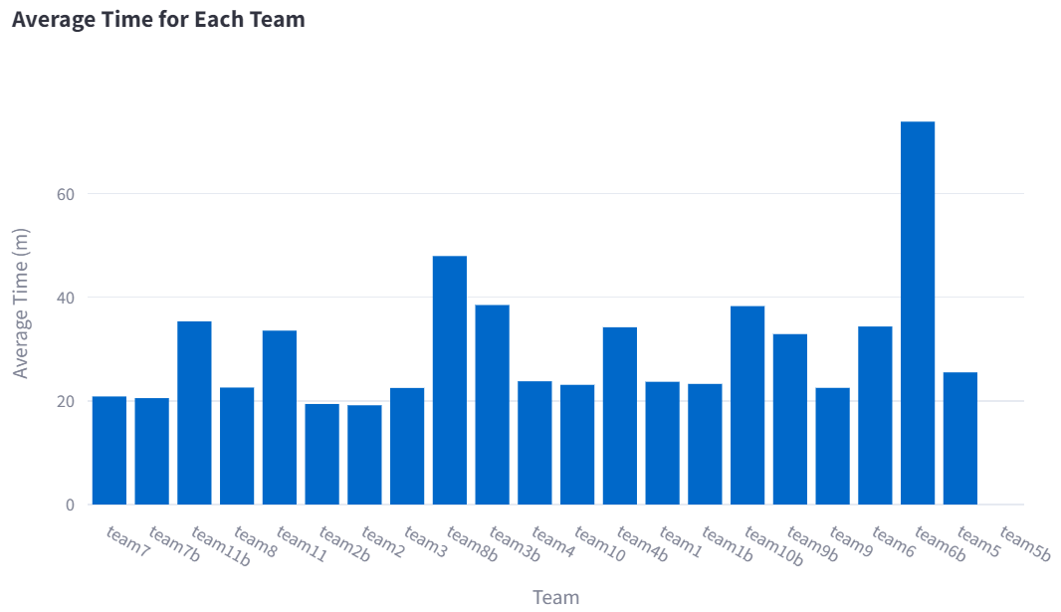
Of the 11 teams we tested, the fastest team was a little unclear at first
Multiple teams could win in under 25 minutes, when they won
Others couldn’t win at all, regardless of time
Results
Mechanics
Background
Experiments
Assumptions
Data
Notes:
Rubric: Results - 5 points. Does the model facilitate solving the problem. Recommendations for future work.

Slide 14
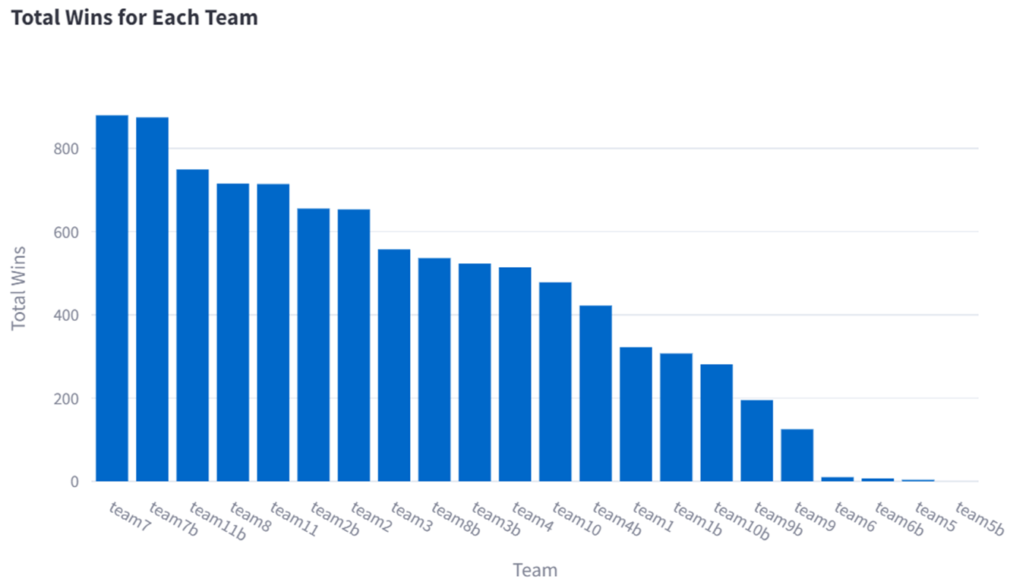
It became much clearer when we involved the win rate as well
Further Research
Results
Mechanics
Background
Experiments
Assumptions
Data
Notes:
Rubric: Results - 5 points. Does the model facilitate solving the problem. Recommendations for future work.

Slide 15
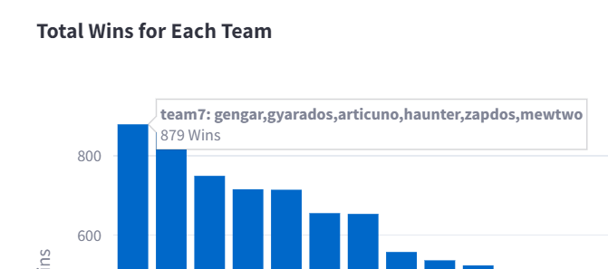
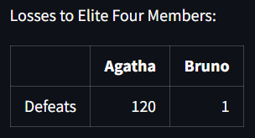
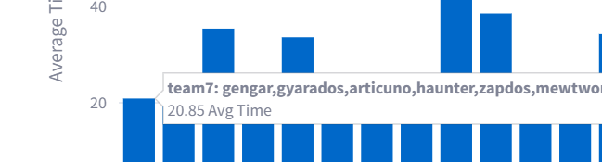
The fastest team with the highest win rate was team 7
Under 21 minutes (<210 actions)
Averaging less than 11 attacks per opponent Pokémon
87.9% win rate
Gengar, Gyarados, Articuno, Haunter, Zapdos, and Mewtwo should run point on our invasion force against the Elite Four
Further Research
Results
Mechanics
Background
Experiments
Assumptions
Data
Notes:
Rubric: Results - 5 points. Does the model facilitate solving the problem. Recommendations for future work.

Slide 16
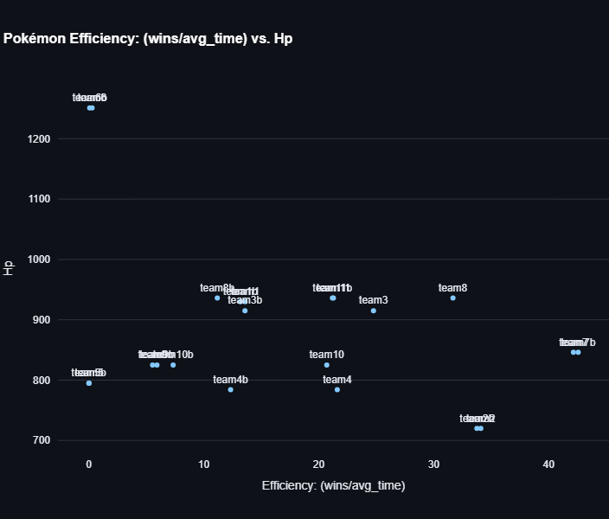
Pokémon Total Team Health vs Efficiency (wins/average time)
Further Research
Results
Mechanics
Background
Experiments
Assumptions
Data
Not a strong positive correlation between Health and Efficiency
Notes:
Rubric: Results - 5 points. Does the model facilitate solving the problem. Recommendations for future work.

Slide 17
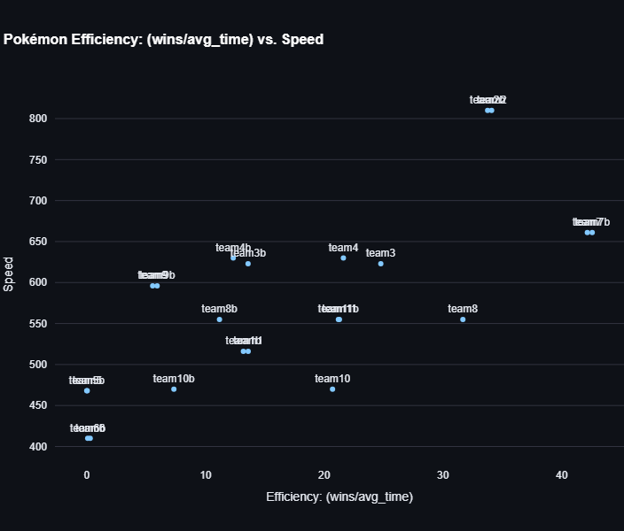
Pokémon Total Team Speed vs Efficiency (wins/average time)
Further Research
Results
Mechanics
Background
Experiments
Assumptions
Data
Noticeable strong positive correlation between Speed and Efficiency
Notes:
Rubric: Results - 5 points. Does the model facilitate solving the problem. Recommendations for future work.

Slide 18
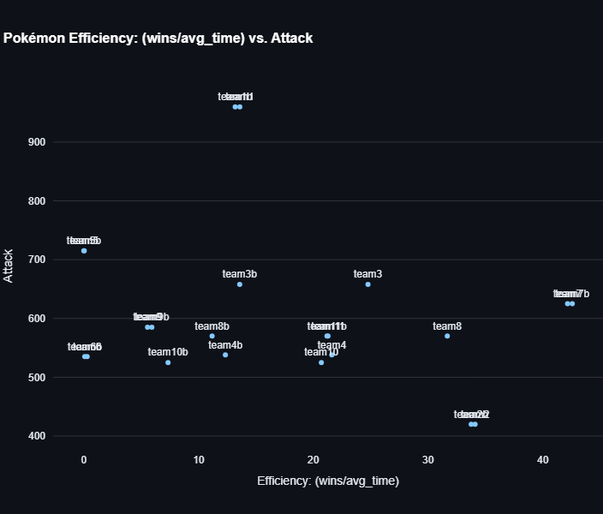
Pokémon Total Team Attack vs Efficiency (wins/average time)
Further Research
Results
Mechanics
Background
Experiments
Assumptions
Data
Little correlation between Attack and Efficiency
Notes:
Rubric: Results - 5 points. Does the model facilitate solving the problem. Recommendations for future work.

Slide 19
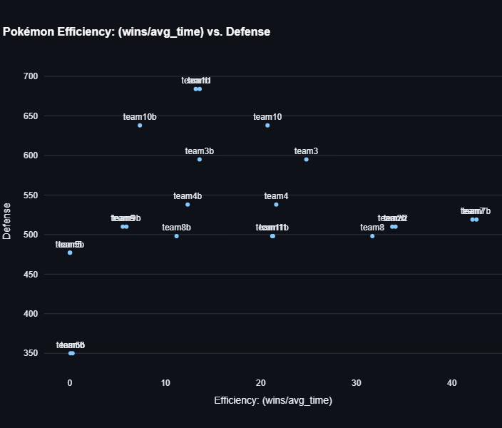
Pokémon Total Team Defense vs Efficiency (wins/average time)
Further Research
Results
Mechanics
Background
Experiments
Assumptions
Data
Weak positive correlation between Health and Efficiency
Notes:
Rubric: Results - 5 points. Does the model facilitate solving the problem. Recommendations for future work.

Slide 20
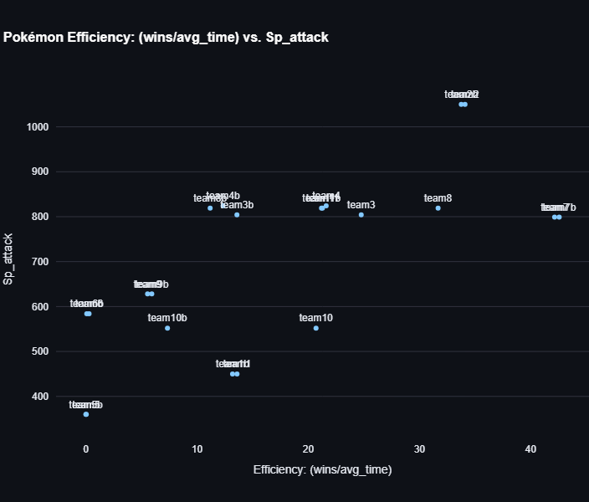
Pokémon Total Team Special Attack vs Efficiency (wins/average time)
Further Research
Results
Mechanics
Background
Experiments
Assumptions
Data
Noticeable strong positive correlation between Special Attack and Efficiency
Notes:
Rubric: Results - 5 points. Does the model facilitate solving the problem. Recommendations for future work.

Slide 21
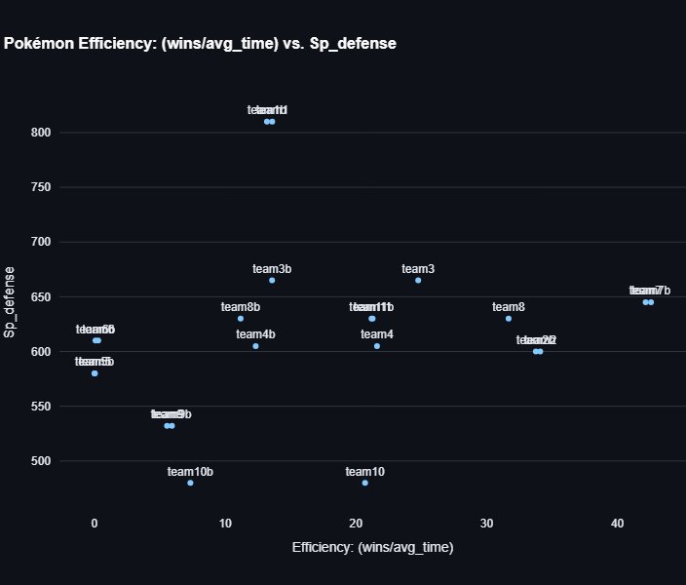
Pokémon Total Team Special Defense vs Efficiency (wins/average time)
Further Research
Results
Mechanics
Background
Experiments
Assumptions
Data
Weak positive correlation between Special Defense and Efficiency
Notes:
Rubric: Results - 5 points. Does the model facilitate solving the problem. Recommendations for future work.

Slide 22
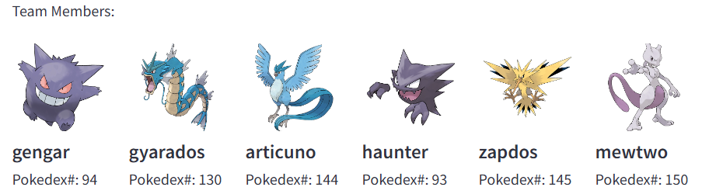
Conclusions:
Invest in teams with high speed and special attack stats
Most teams’ orders do not result in significant performance change
Some models are best performed with Python instead of Simio
Gengar, Gyarados, Articuno, Haunter, Zapdos, and Mewtwo should run point on our invasion force against the Elite Four
Under 21 minutes (<210 actions)
87.9% win rate
Highest individual win rates
Further Research
Results
Mechanics
Background
Experiments
Assumptions
Data
Notes:
Rubric: Results - 5 points. Does the model facilitate solving the problem. Recommendations for future work.

Slide 23
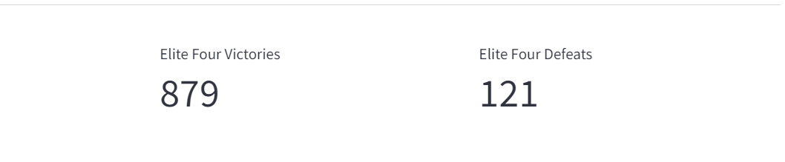
Find a team that beats Agatha even more consistently
Repeat experiment at Level 100
Add move limits (PP)
Allow item usage
Allow for move selection input
Compare available moves for each Pokémon
Do moves affect outcome more than stats?
Train an AI for each Pokémon to handle the move inputs
Test all 11,853,911,588,401 possible combinations
Results
Mechanics
Background
Further Research
Experiments
Assumptions
Data
Notes:
Rubric: Results - 5 points. Does the model facilitate solving the problem. Recommendations for future work.

Slide 24

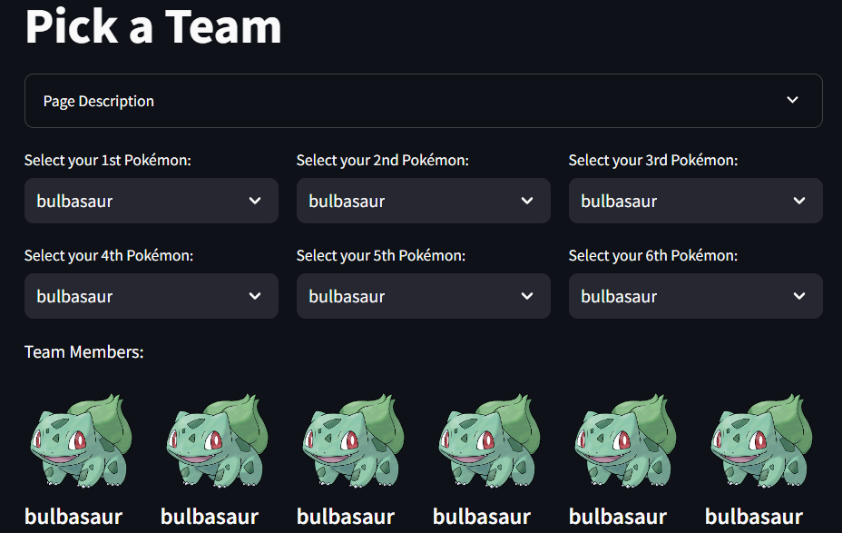
Streamlit App
Further Research
Mechanics
Questions
Results
Background
Experiments
Assumptions
Data
Notes:
Rubric: Results - 5 points. Does the model facilitate solving the problem. Recommendations for future work.

Slide 25
Further Research
Mechanics
Questions
Results
Background
Experiments
Assumptions
Data
Notes:
Rubric: Results - 5 points. Does the model facilitate solving the problem. Recommendations for future work.

Slide 27
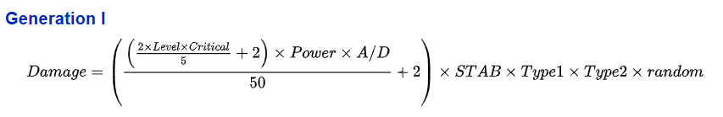
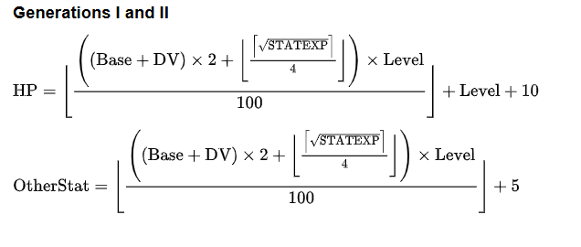
Appendix Slides
For leveling up the Pokémon, we set DV and STATEXP t = 0. These are values dependent on the Pokémon and how many prior battles it has undergone.
Notes:
When we last saw our heroes: Data and code from previous Monte Carlo
Problem statement: How can we shape a team to take on the elite team the fastest?
Slide on flowchart
Slide on event relationship graph
Slide on assumptions: Pokémon have access to all moves, all level 50,etc
Expand to 6 v 5 team battles
Expand to 1 team vs 4 teams
Expand to level 50 – random moves from them
Expand to track time in the battle with 6 seconds per round.
Attempt to input it into Simio – Constant problems multiple servers, multiple customers, each customer has different interactions with each server, multiple distributions
Realize that it’s easier to implement in Python
Team choices – High defense, high attack,
Results
Team Gyarados
Team Gengar
Hayden's main team - All Legendaries + Cool Turtle
Hayden's second team - no legendaries
Hayden's fighting team
Hayden's high hp team
Top Winners
Corinne's vague attempt at type matching
Just Birds
David's nostalgia

